Slide 1

Chapter 2
Network Models
2.<number>
Copyright © The McGraw-Hill Companies, Inc. Permission required for reproduction or display.

Slide 2
2-1 LAYERED TASKS
We use the concept of layers in our daily life. As an example, let us consider two friends who communicate through postal mail. The process of sending a letter to a friend would be complex if there were no services available from the post office.
Topics discussed in this section:
Sender, Receiver, and Carrier
Hierarchy
2.<number>

Slide 3

Figure 2.1 Tasks involved in sending a letter
2.<number>

Slide 4
2-2 THE OSI MODEL
Established in 1947, the International Standards Organization (ISO) is a multinational body dedicated to worldwide agreement on international standards. An ISO standard that covers all aspects of network communications is the Open Systems Interconnection (OSI) model. It was first introduced in the late 1970s.
Topics discussed in this section:
Layered Architecture
Peer-to-Peer Processes
Encapsulation
2.<number>

Slide 5

Note
ISO is the organization.
OSI is the model.
2.<number>

Slide 6

Figure 2.2 Seven layers of the OSI model
2.<number>

Slide 7

Figure 2.3 The interaction between layers in the OSI model
2.<number>

Slide 8

Figure 2.4 An exchange using the OSI model
2.<number>

Slide 9
2-3 LAYERS IN THE OSI MODEL
In this section we briefly describe the functions of each layer in the OSI model.
Topics discussed in this section:
Physical Layer
Data Link Layer
Network Layer
Transport Layer
Session Layer
Presentation Layer
Application Layer
2.<number>

Slide 10

Figure 2.5 Physical layer
2.<number>

Slide 11

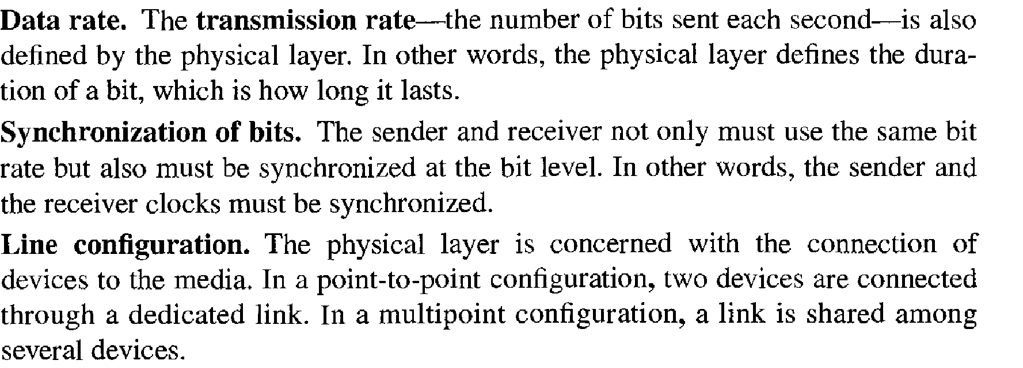
The physical layer is responsible for movements of
individual bits from one hop (node) to the next.
2.<number>

Slide 12
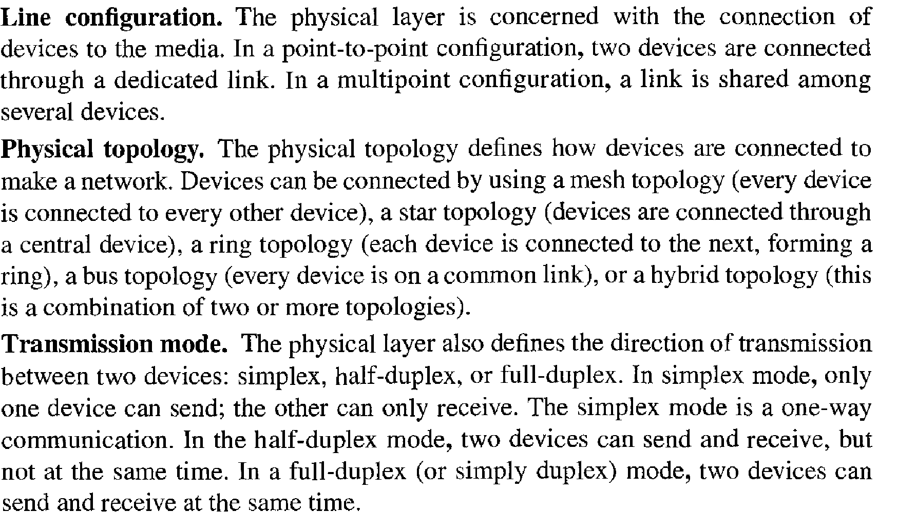
2.<number>

Slide 13

Figure 2.6 Data link layer
2.<number>

Slide 14
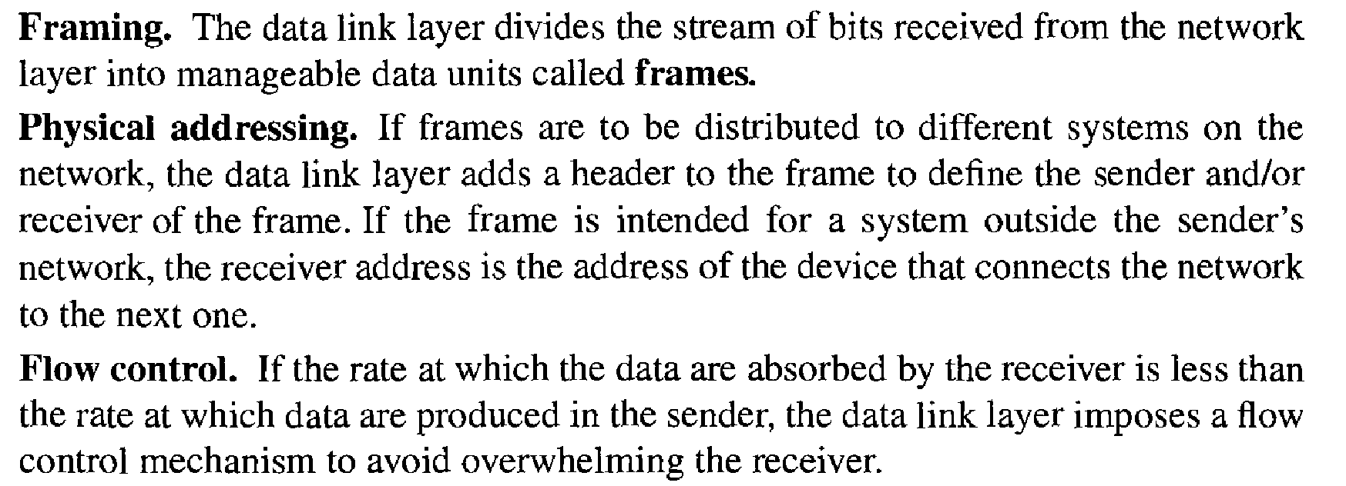
The data link layer is responsible for moving
frames from one hop (node) to the next.
2.<number>

Slide 15
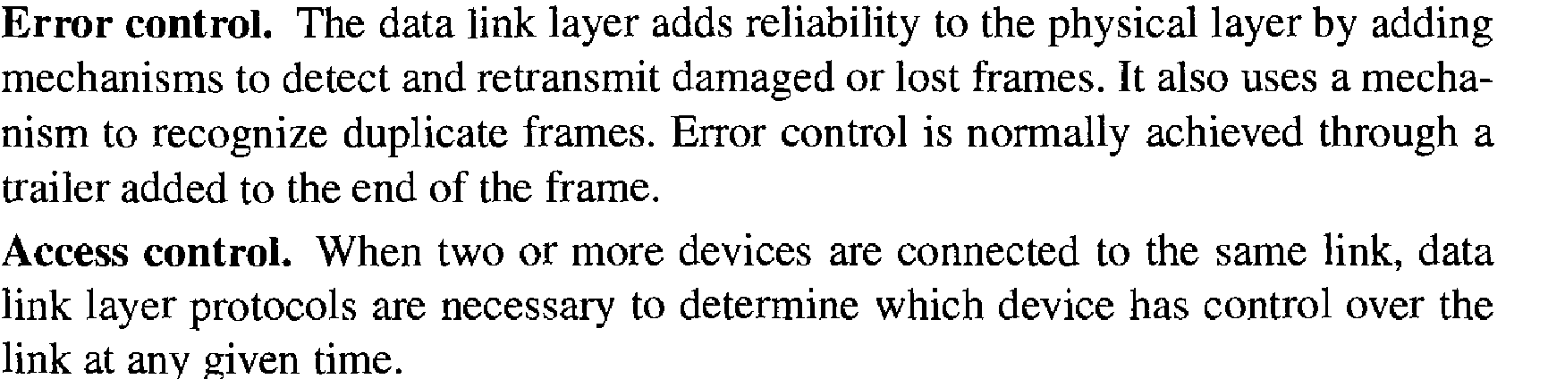
2.<number>

Slide 16

Figure 2.7 Hop-to-hop delivery
2.<number>

Slide 17

Figure 2.8 Network layer
2.<number>

Slide 18
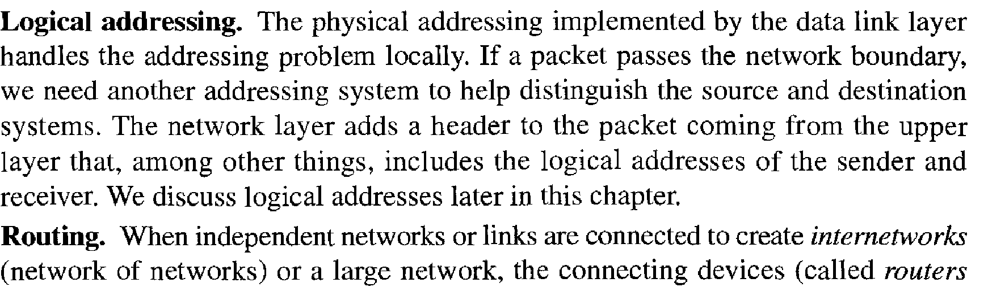
The network layer is responsible for the
delivery of individual packets from
the source host to the destination host.
2.<number>

Slide 19

Figure 2.9 Source-to-destination delivery
2.<number>

Slide 20

Figure 2.10 Transport layer
2.<number>

Slide 21
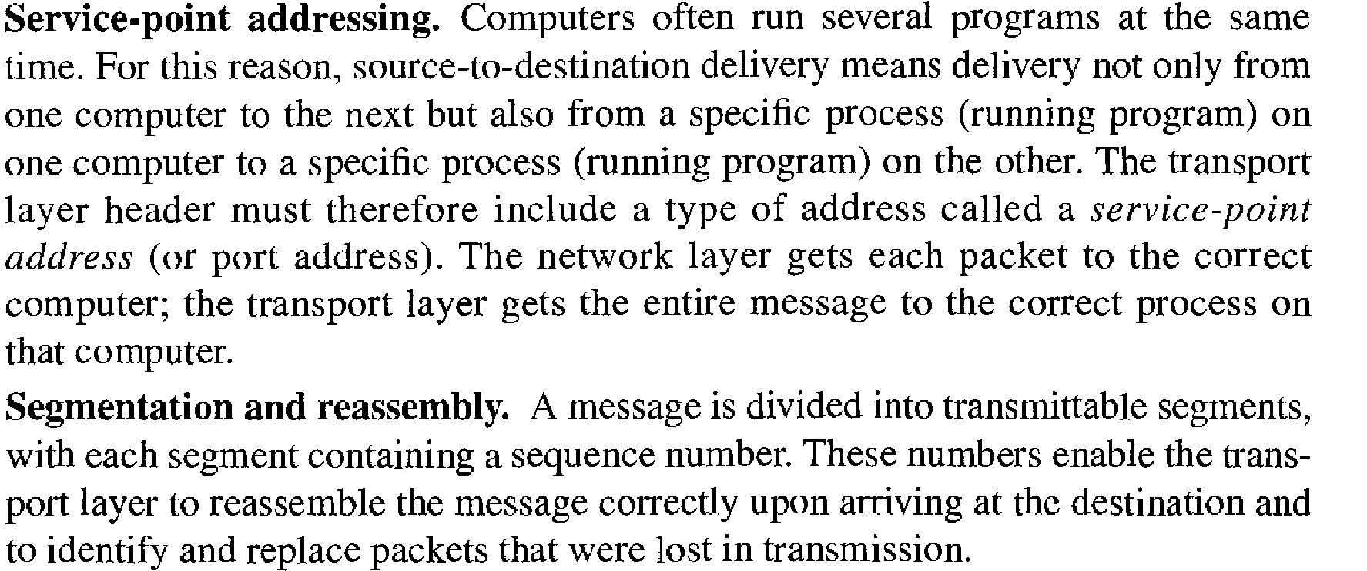
The transport layer is responsible for the delivery
of a message from one process to another.
2.<number>

Slide 22
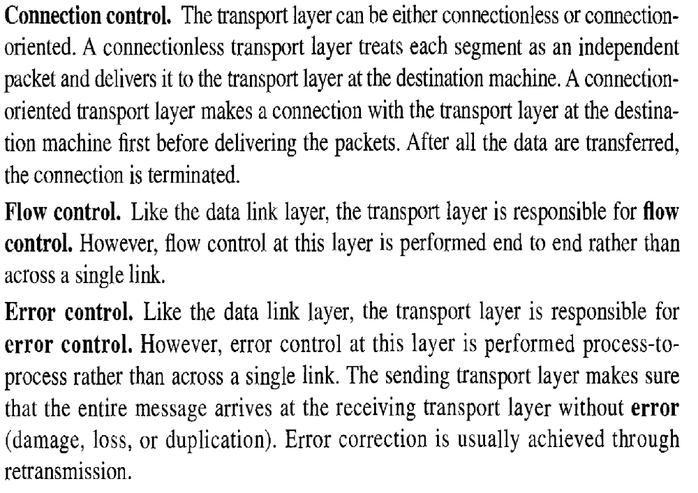
2.<number>

Slide 23

Figure 2.11 Reliable process-to-process delivery of a message
2.<number>

Slide 24

Figure 2.12 Session layer
2.<number>

Slide 25
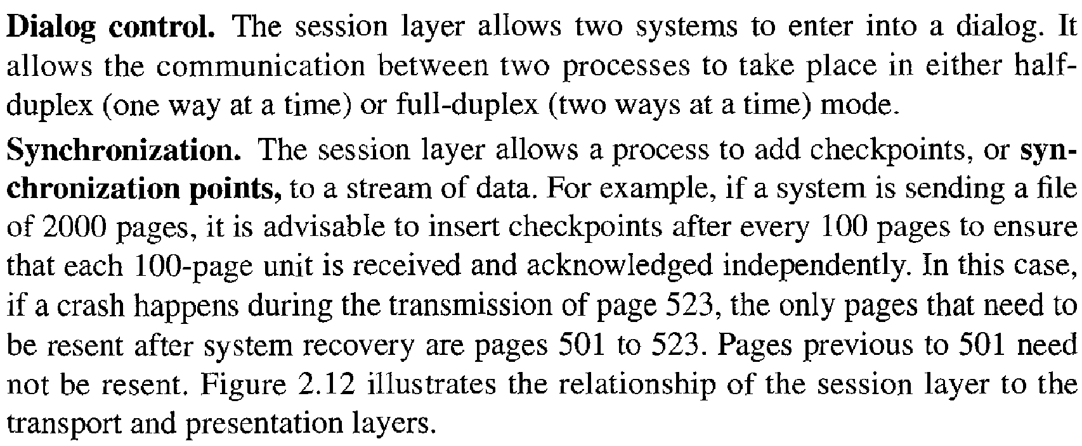
The session layer is responsible for dialog
control and synchronization.
2.<number>

Slide 26

Figure 2.13 Presentation layer
2.<number>

Slide 27
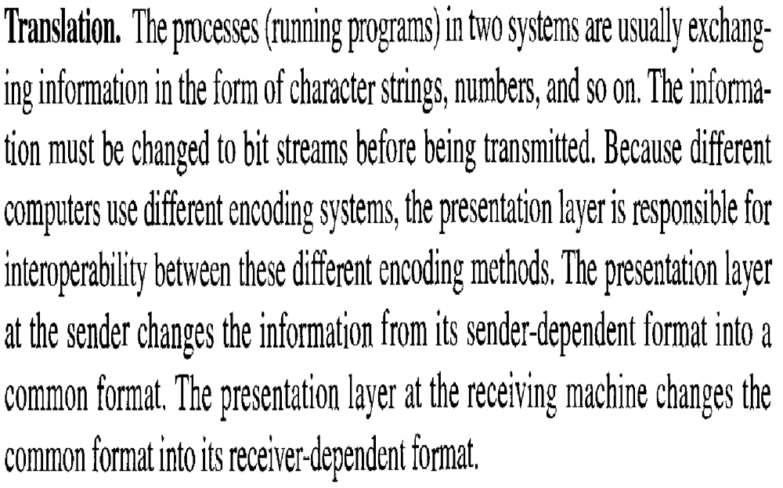
The presentation layer is responsible for translation, compression, and encryption.
2.<number>

Slide 28
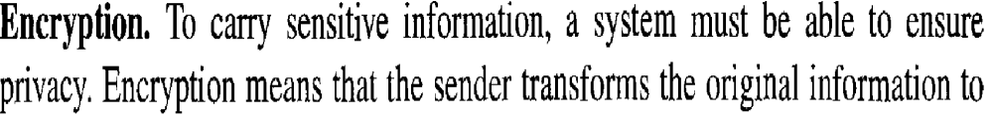
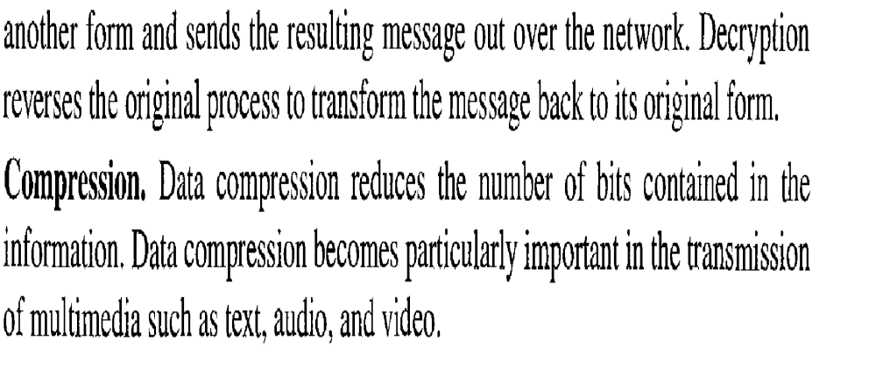
2.<number>

Slide 29

Figure 2.14 Application layer
2.<number>

Slide 30
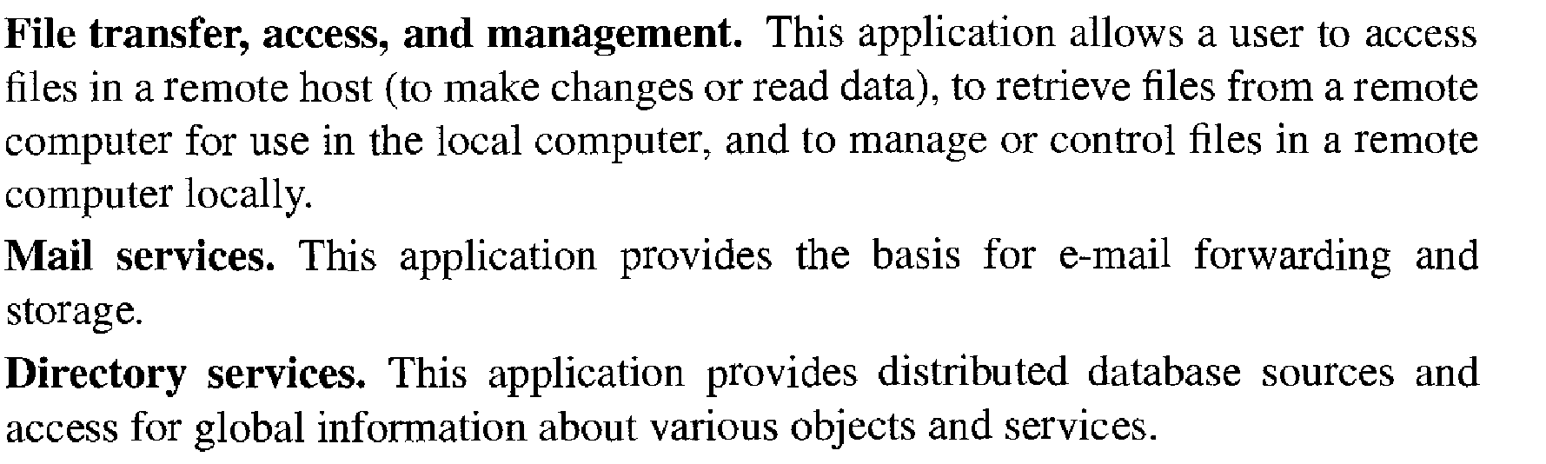
The application layer is responsible for
providing services to the user.
2.<number>

Slide 31

Figure 2.15 Summary of layers
2.<number>

Slide 32
2-4 TCP/IP PROTOCOL SUITE
The layers in the TCP/IP protocol suite do not exactly match those in the OSI model. The original TCP/IP protocol suite was defined as having four layers: host-to-network, internet, transport, and application. However, when TCP/IP is compared to OSI, we can say that the TCP/IP protocol suite is made of five layers: physical, data link, network, transport, and application.
Topics discussed in this section:
Physical and Data Link Layers
Network Layer
Transport Layer
Application Layer
2.<number>

Slide 33

Figure 2.16 TCP/IP and OSI model
2.<number>

Slide 34
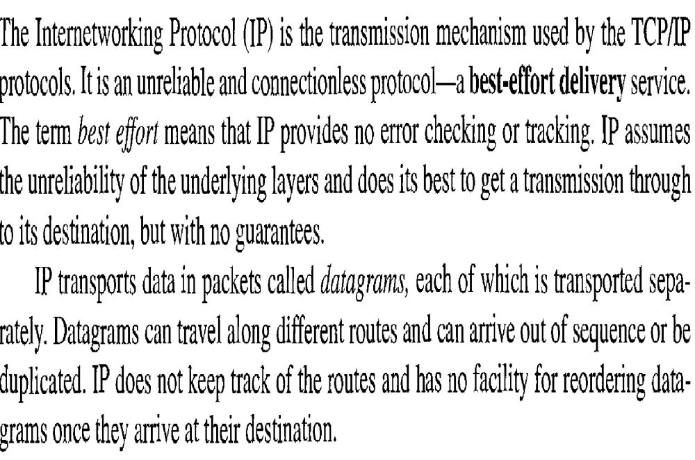
2.<number>

Slide 35
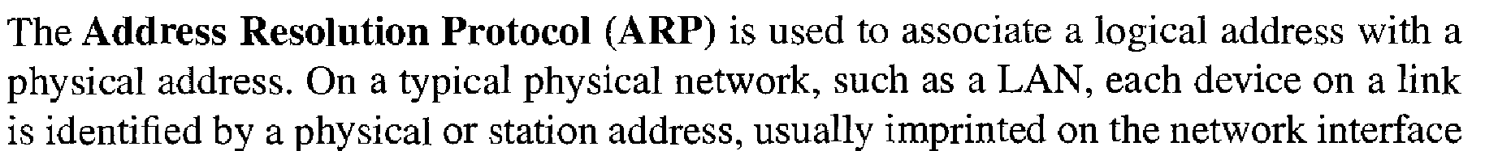
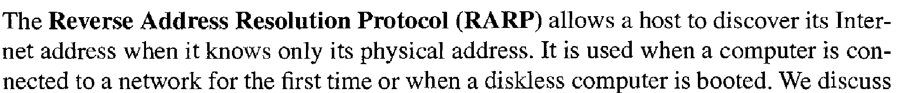
2.<number>

Slide 36
2.<number>

Slide 37
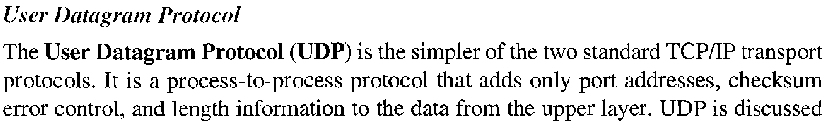
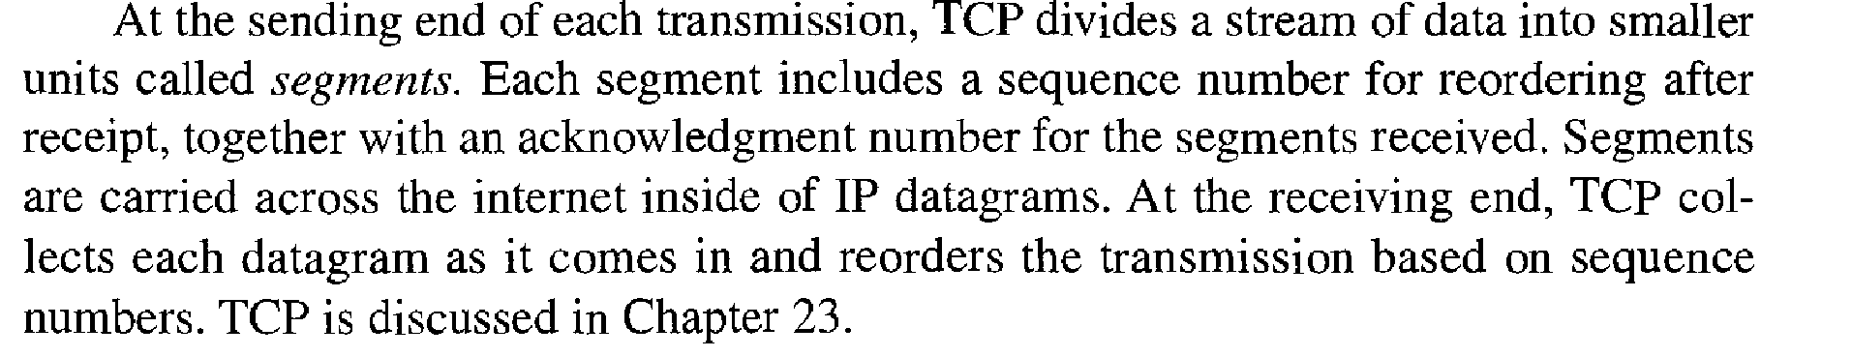
2.<number>

Slide 38
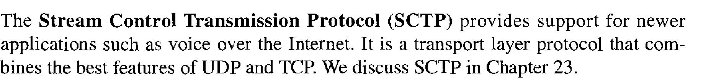
2.<number>

Slide 39
2-5 ADDRESSING
Four levels of addresses are used in an internet employing the TCP/IP protocols: physical, logical, port, and specific.
Topics discussed in this section:
Physical Addresses
Logical Addresses
Port Addresses
Specific Addresses
2.<number>

Slide 40

Figure 2.17 Addresses in TCP/IP
2.<number>

Slide 41

Figure 2.18 Relationship of layers and addresses in TCP/IP
2.<number>

Slide 42
Example 2.1
In Figure 2.19 a node with physical address 10 sends a frame to a node with physical address 87. The two nodes are connected by a link (bus topology LAN). As the figure shows, the computer with physical address 10 is the sender, and the computer with physical address 87 is the receiver.
2.<number>

Slide 43

Figure 2.19 Physical addresses
2.<number>

Slide 44
Example 2.2
As we will see in Chapter 13, most local-area networks use a 48-bit (6-byte) physical address written as 12 hexadecimal digits; every byte (2 hexadecimal digits) is separated by a colon, as shown below:
07:01:02:01:2C:4B
A 6-byte (12 hexadecimal digits) physical address.
2.<number>

Slide 45
Example 2.3
Figure 2.20 shows a part of an internet with two routers connecting three LANs. Each device (computer or router) has a pair of addresses (logical and physical) for each connection. In this case, each computer is connected to only one link and therefore has only one pair of addresses. Each router, however, is connected to three networks (only two are shown in the figure). So each router has three pairs of addresses, one for each connection.
2.<number>

Slide 46

Figure 2.20 IP addresses
2.<number>

Slide 47
Example 2.4
Figure 2.21 shows two computers communicating via the Internet. The sending computer is running three processes at this time with port addresses a, b, and c. The receiving computer is running two processes at this time with port addresses j and k. Process a in the sending computer needs to communicate with process j in the receiving computer. Note that although physical addresses change from hop to hop, logical and port addresses remain the same from the source to destination.
2.<number>

Slide 48

Figure 2.21 Port addresses
2.<number>

Slide 49
Note
The physical addresses will change from hop to hop,
but the logical addresses usually remain the same.
2.<number>

Slide 50
Example 2.5
As we will see in Chapter 23, a port address is a 16-bit address represented by one decimal number as shown.
753
A 16-bit port address represented
as one single number.
2.<number>

Slide 51
Note
The physical addresses change from hop to hop,
but the logical and port addresses usually remain the same.
2.<number>

